Slide 1
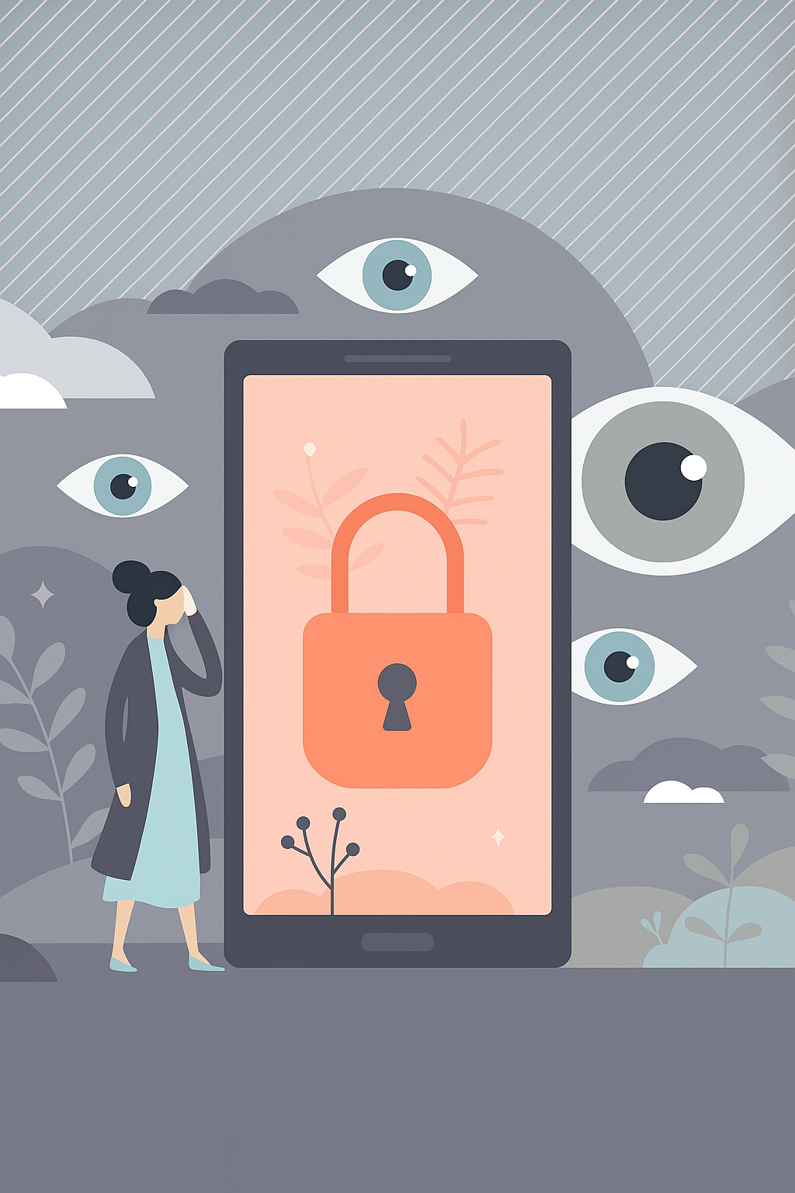
Beyond the Price Tag: Examining User Behavior and Trust in Free VPN Services
Human-centered cybersecurity research on privacy paradox in free VPN use.
Presented By - Kurudunje Deekshith Shetty
Shitil Shetty

Slide 2
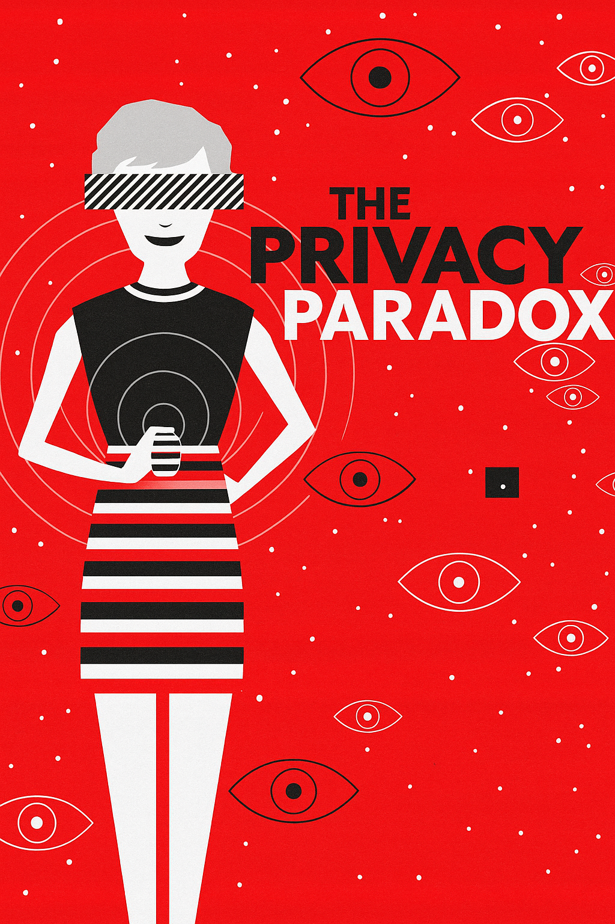
Hook : The Privacy Paradox
Widespread use
Hidden risks
Millions use free VPNs seeking privacy and anonymity
Users often expose data to tracking and weak security
Research focus
Why do users choose free VPNs despite low trust? This paradox is our focus.
Investigating gap between trust and real privacy risks
Our study uncovers trust dynamics, usage patterns, and risks in free VPNs.
Notes:
"Picture this: you use a free VPN to protect your online privacy, but your data is tracked or sold. Millions choose free VPNs for security, yet many face risks like data leaks or weak encryption. This contradiction—seeking privacy but using risky tools—is the privacy paradox. Our research explores why users trust free VPNs, what drives their choices, and how we can make the VPN ecosystem safer."

Slide 3

VPN Privacy Background
VPN Basics
Free VPN Risks
User Preferences
Encrypts traffic to protect user data and privacy.
Often log activities, display ads, or inject malware.
Privacy valued, but convenience often drives choices.
Notes:
"Let’s set the stage. Virtual Private Networks, or VPNs, encrypt your internet traffic and hide your IP address, safeguarding you from surveillance or breaches. They’re essential for privacy. But free VPNs, despite their popularity, often monetize user data, log activities, or use outdated encryption, exposing users to risks. With growing global privacy concerns, many still choose these free options, creating a privacy paradox where convenience trumps security. Our study investigates this tension."

Slide 4

How much do users understand and trust free VPN data practices?
Why choose free over paid VPNs?
What issues do users encounter?
What risks do users perceive, and how important is privacy?
Notes:
"We asked four key questions: How much do users trust free VPNs’ data practices? Why choose free over paid? What issues do they face? And how do they view risks? We conducted two surveys.

Slide 5
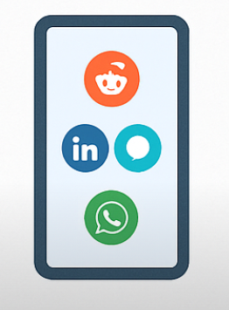


Study Methodology
Survey Samples
Distribution Channels
Analysis Techniques
94 general users
16 security-aware users
Reddit, LinkedIn
Likert scales
Open-ended responses
Descriptive statistics
Notes:
The first, in April 2025, gathered 94 general users via Reddit and LinkedIn, using 22 questions to capture usage, trust, and risks. The second, from April 11-19, surveyed 16 cybersecurity students for technical perspectives. We used statistics for quantitative data and coded open-ended responses for themes, ensuring a comprehensive analysis."

Slide 6
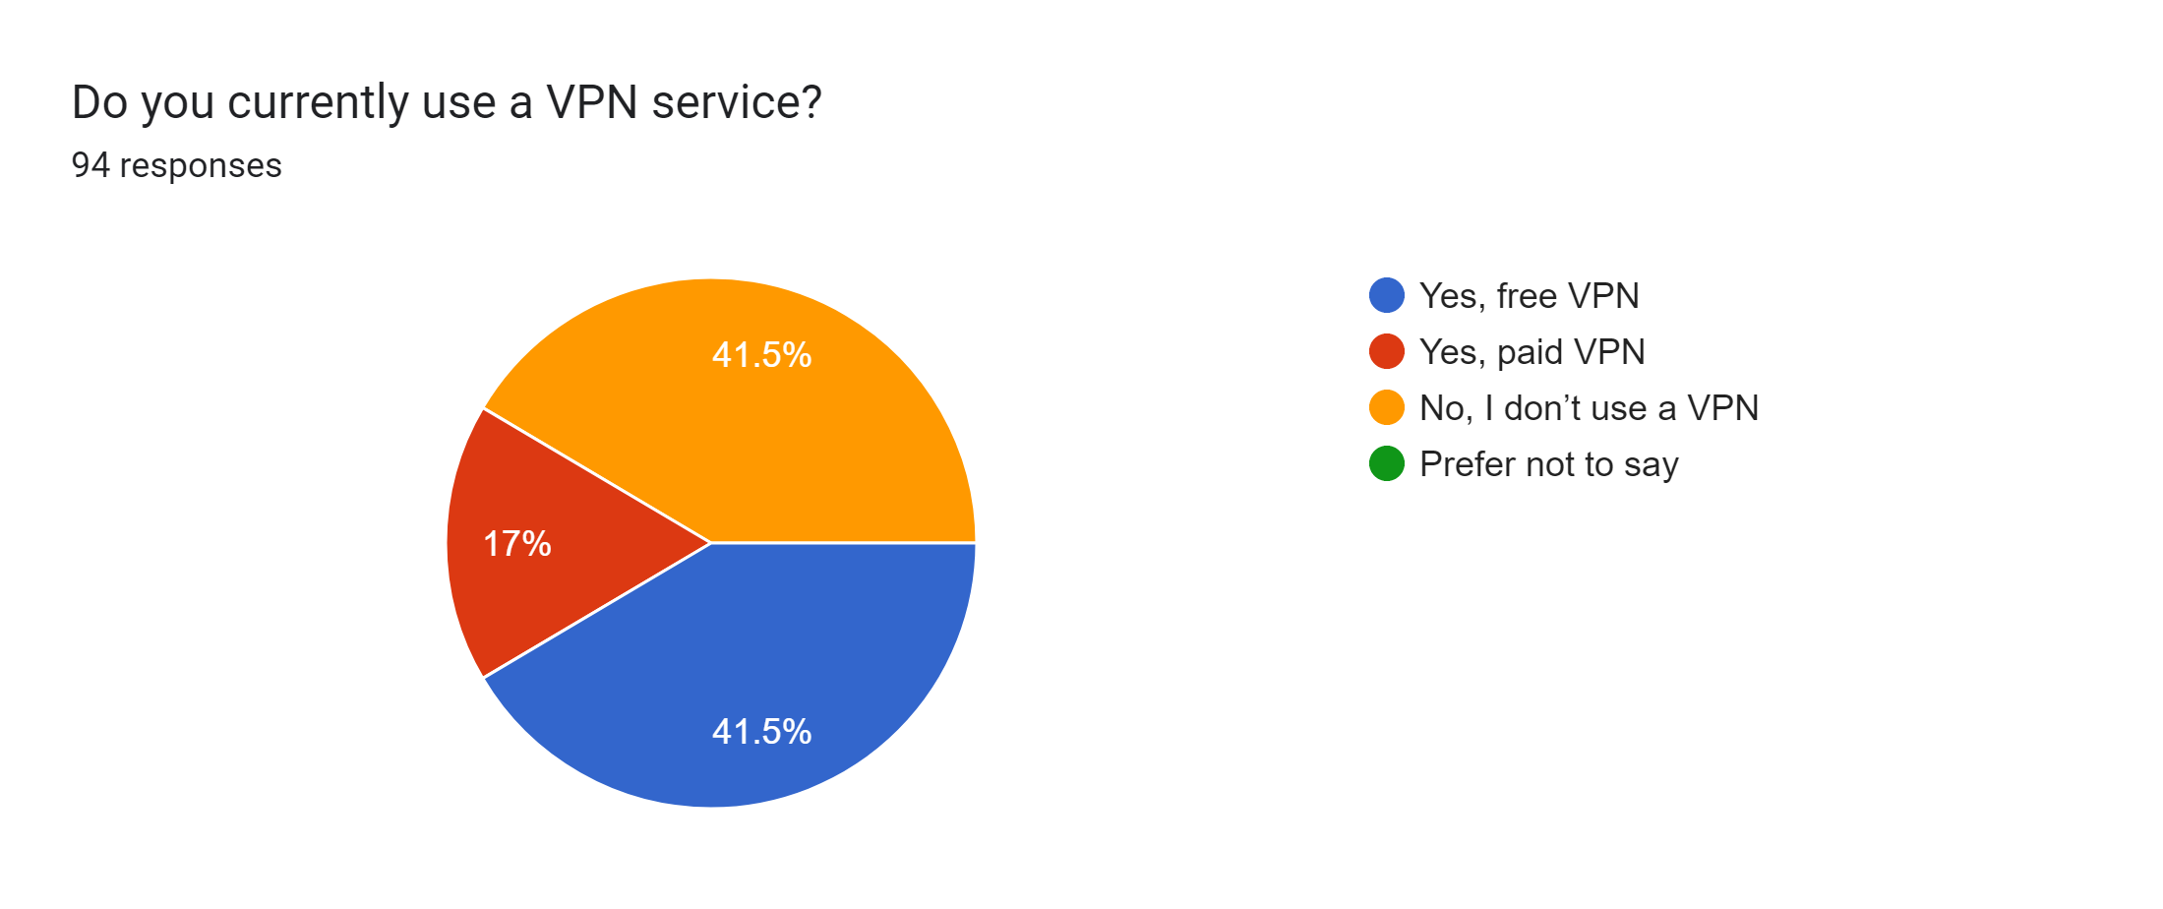
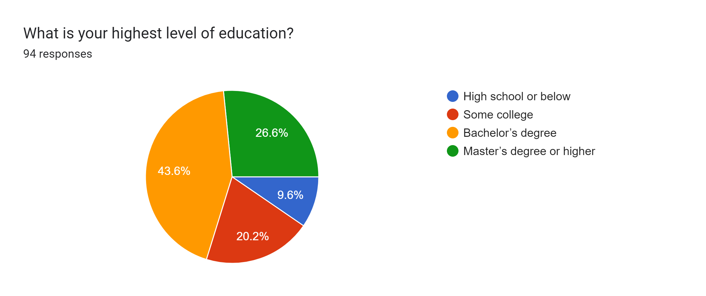
User Profiles & Behavior
General Users
Young (61.7% aged 18-24), gender-balanced (46.8% male, 51% female), intermediate tech skills (67%)
41.5% use free VPNs, 17% paid, 41.5% none.
Uses: anonymous browsing (52.6%), streaming (34.6%), remote work/gaming (17.9%)
Avoid sensitive tasks (63.8% never use for banking)
Security aware users
Prefer paid VPNs (43.8%) or none (37.5%), use free VPNs for low-risk tasks
General user’s usage
General user’s education level
Notes:
"Our users differ sharply. General users, mostly 18-24 with moderate tech skills, split evenly: 41.5% use free VPNs, 17% paid, and 41.5% none. They focus on browsing, streaming, or remote work but avoid sensitive tasks like banking, showing distrust. Security-aware users, with advanced skills, prefer paid VPNs or skip them, using free ones only for casual tasks, as ‘goofy-liskov’ called them a ‘quick solution.’ Figure 1 highlights this divide, showing knowledge drives safer choices."

Slide 7
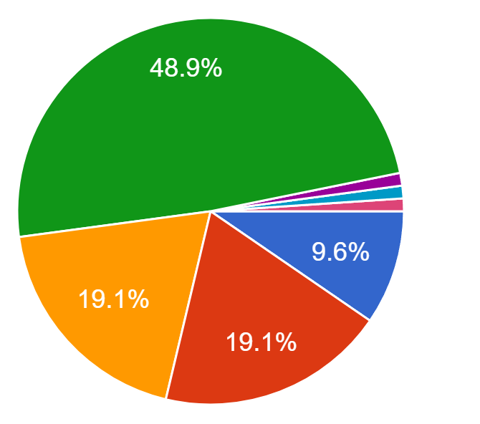
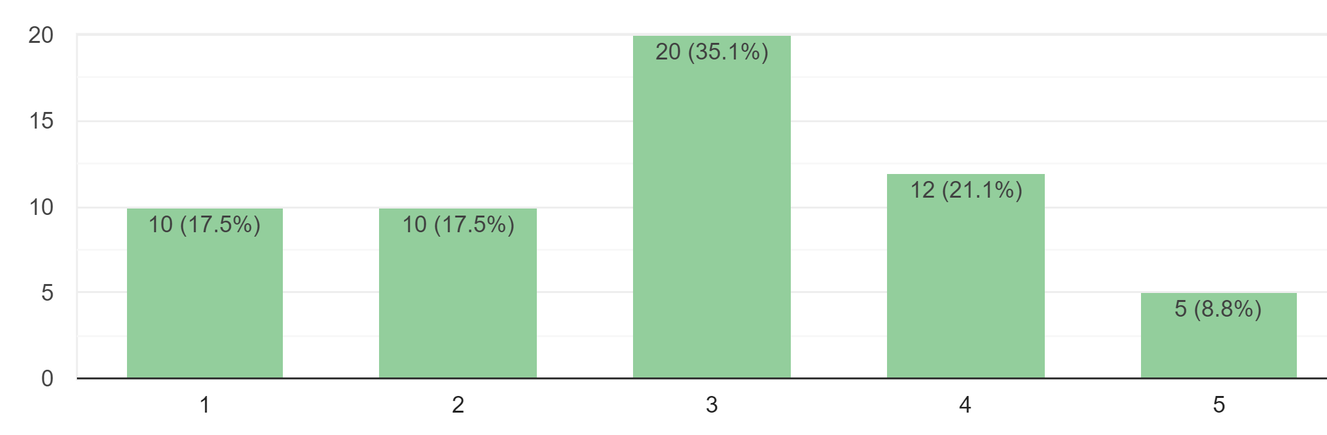
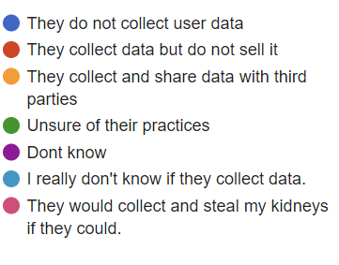
Trust and Data Practices
General Users
Low trust: 30.9% minimal, 37.2% neutral, only 1.1% complete trust
Limited understanding: Almost 50% unsure of data practices, 46.5% never read terms
“A transparent privacy policy that states they don’t log, track, or sell user data”.
Security aware users
Lower trust: 37.5% rate 1/5, none above 3/5
General users T&C Understanding
Opinion of data practices
Notes:
"Trust is a major issue. General users show low trust—30.9% give minimal trust, and only 1.1% fully trust free VPNs. Nearly half, 48.9%, are unsure about data practices, and 46.5% never read terms. Security-aware users are even more skeptical, with 37.5% rating trust at 1/5 and none above neutral. They assume data like browsing history is collected, as ‘ecstatic-cori’ noted. P17 summed it up: trust needs ‘a transparent privacy policy that states they don’t log, track, or sell data.’ Figure 2 shows this stark trust gap."

Slide 8
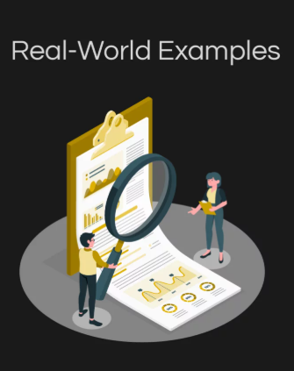
Reasons for Using Free VPNs
73.5%
33.7%
Cost
Ease of Access
Main motivation for choosing free VPNs.
Important factor in platform selection.
25%
Lack of Awareness
Some unaware that paid VPN options exist.
Notes:
"Why choose free VPNs? General users cite cost—73.5%—and ease of access, with P15 saying it’s about ‘cost (free service).’ Some, 14.5%, don’t know paid options exist. Security-aware users use them for convenience in low-stakes tasks, per ‘goofy-liskov.’

Slide 9

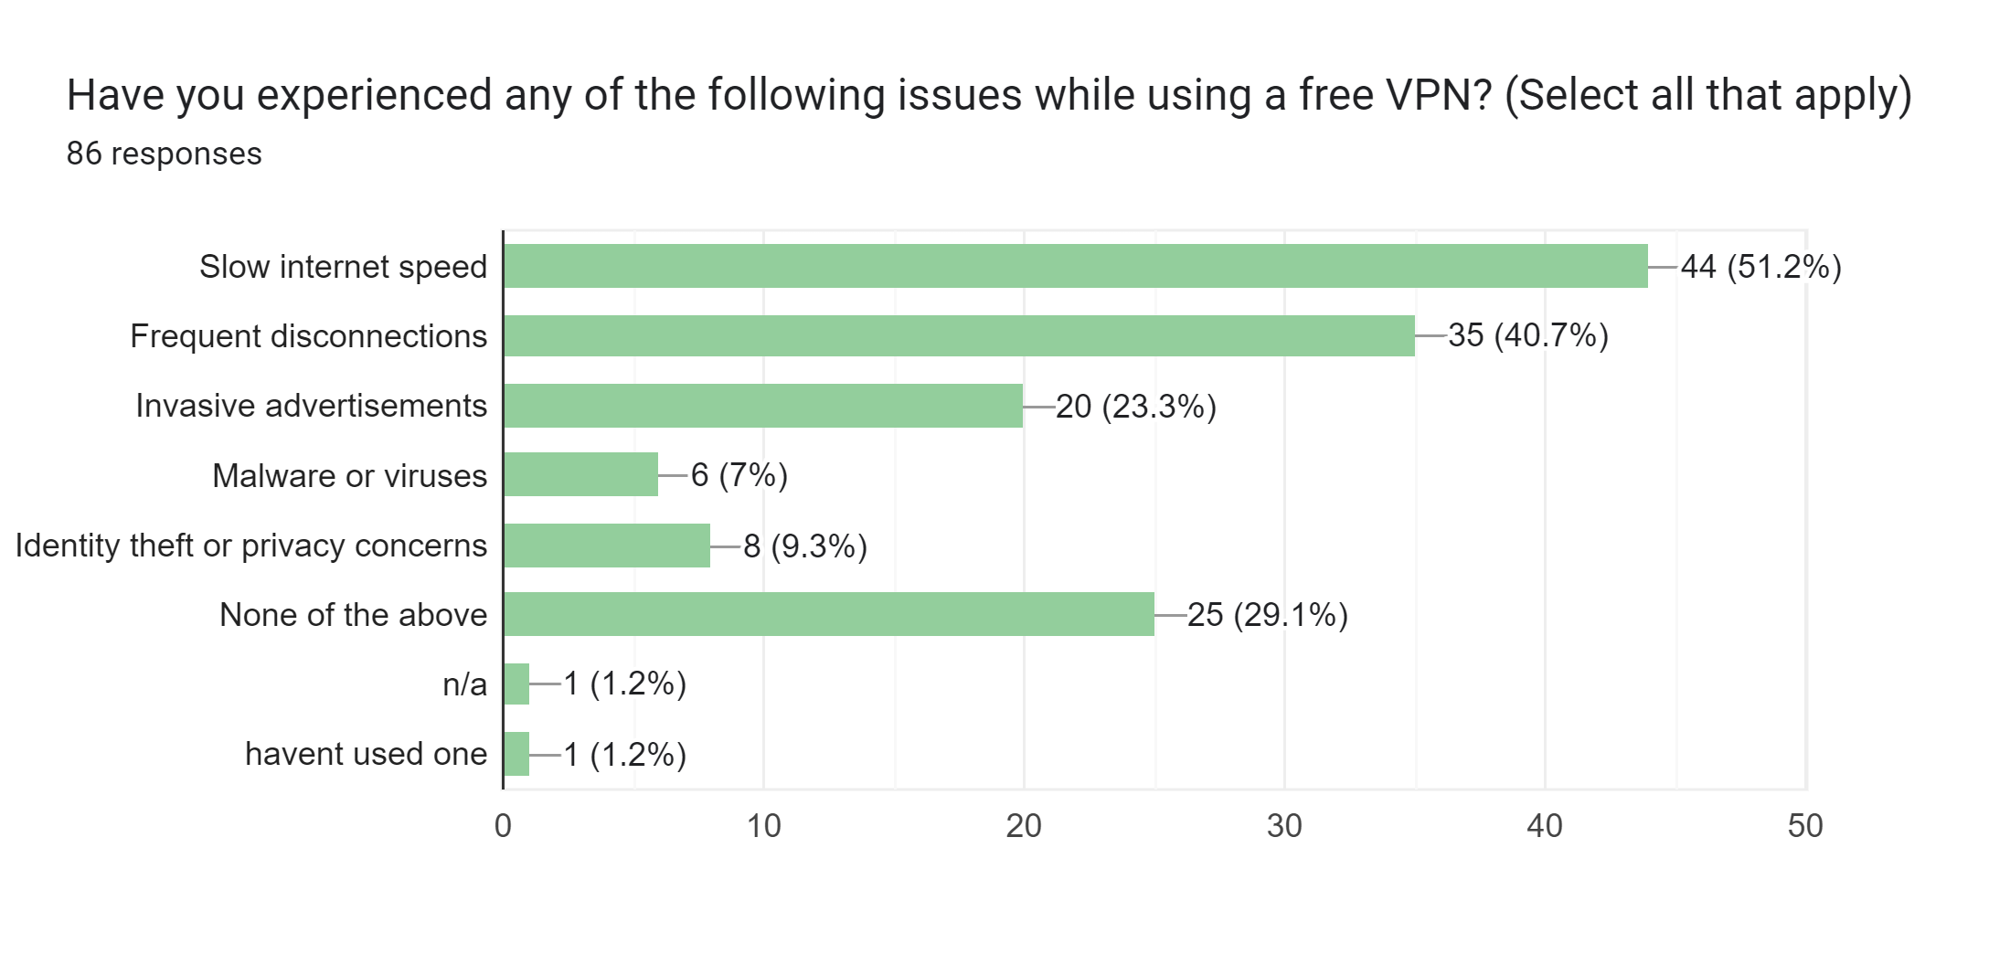
Common Issues
General users:
Security Aware:
Weak encryption (68.8%), data logging (93.8%), malware (62.5%)
Slow speeds (51.2%), disconnections (40.7%), ads (23.3%)
Notes:
Issues persist : general users face slow speeds, disconnections, and ads, as P3 noted with ‘frequent disconnections.’ Security-aware users highlight deeper flaws like weak encryption and data logging, with 93.8% citing it as a concern.

Slide 10
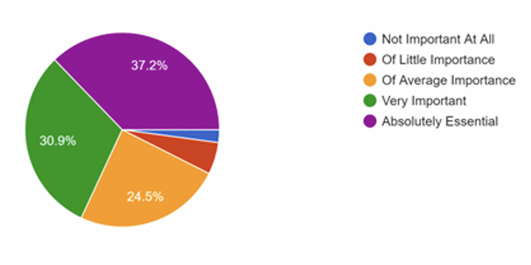
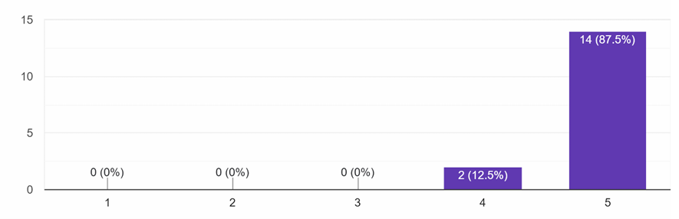
Perceived Risks and Transparency
Risks:
General users: Data privacy (35.9%), security vulnerabilities (15.2%), scams (8.7%)
Security-aware: Data logging (93.8%), weak encryption (68.8%), third-party data sharing (100%)
“Everything you do through an untrustworthy free VPN should be expected to be monitored, tracked, and sold” (P17)
Transparency:
General users: 37.2% rate it “absolutely essential”
Security-aware: 87.5% rate it “absolutely essential”
Importance of transparency(Security aware)
Importance of transparency(general)
Notes:
"Both groups worry about risks, especially data privacy—35.9% for general users, 93.8% for security-aware. General users also fear security flaws and scams, while security-aware users universally flag third-party data sharing. P17 warned, ‘Everything you do through an untrustworthy free VPN should be expected to be monitored, tracked, and sold.’ Transparency is critical: 37.2% of general users and 87.5% of security-aware users call it ‘absolutely essential.’ Figure 3 shows this shared demand for clear data practices."

Slide 11
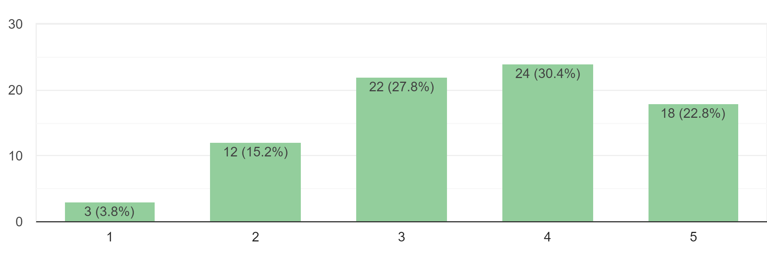
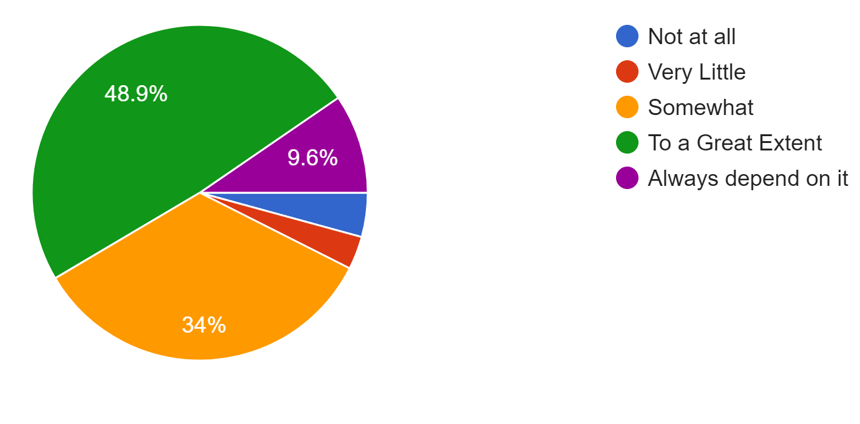
Knowledge Gaps and Recommendations
Knowledge Gaps::
General users: 48.9% unsure of data practices, 13% unaware of paid VPNs, some confused
Security-aware: High VPN knowledge (75% at 4/5 or higher), critical of data monetization
“Not really sure what it is” - P18
Recommendations::
Security-aware: Public audits (75%), open-source code (68.8%), no-ads policies (50%)
General users: Clear policies, user-accessible data logs
Adoption of better, paid options with knowledge
Positive Reviews influence
Notes:
"Knowledge gaps are stark. Nearly half of general users, 48.9%, are unsure about data practices, and 13% don’t know paid VPNs exist. Some, like P18, admit, ‘Not really sure what it is.’ Security-aware users, with 75% rating their VPN knowledge high, criticize data monetization. They recommend public audits, open-source code, and no-ads policies, warning of ‘a false sense of security,’ per ‘interesting-buck.’ General users echo the need for clear policies and accessible data logs, pointing to education as a solution."

Slide 12

Summary and Applications
Summary:
Free VPNs draw users with cost but lose trust due to poor transparency
General users’ low awareness vs. security-aware users’ skepticism
Transparency is universal demand (37.2% general, 87.5% security-aware)
Applications:
Users: Check privacy policies, choose reputable providers
Providers: Adopt clear policies, third-party audits, open-source code
Policymakers: Mandate transparent data disclosures
Notes:
"Our findings confirm the privacy paradox: free VPNs attract users with cost but erode trust with unclear data practices. General users’ limited knowledge contrasts with security-aware users’ informed critiques, yet both demand transparency—37.2% of general users and 87.5% of security-aware rate it essential. ‘Cranky-wilbur’ summed up the risks: ‘data collection, hidden tracking, selling user data.’ Users should compare policies and pick reputable tools. Providers need clear policies and audits, while policymakers can enforce transparency. These steps can bridge the trust gap."

Slide 13
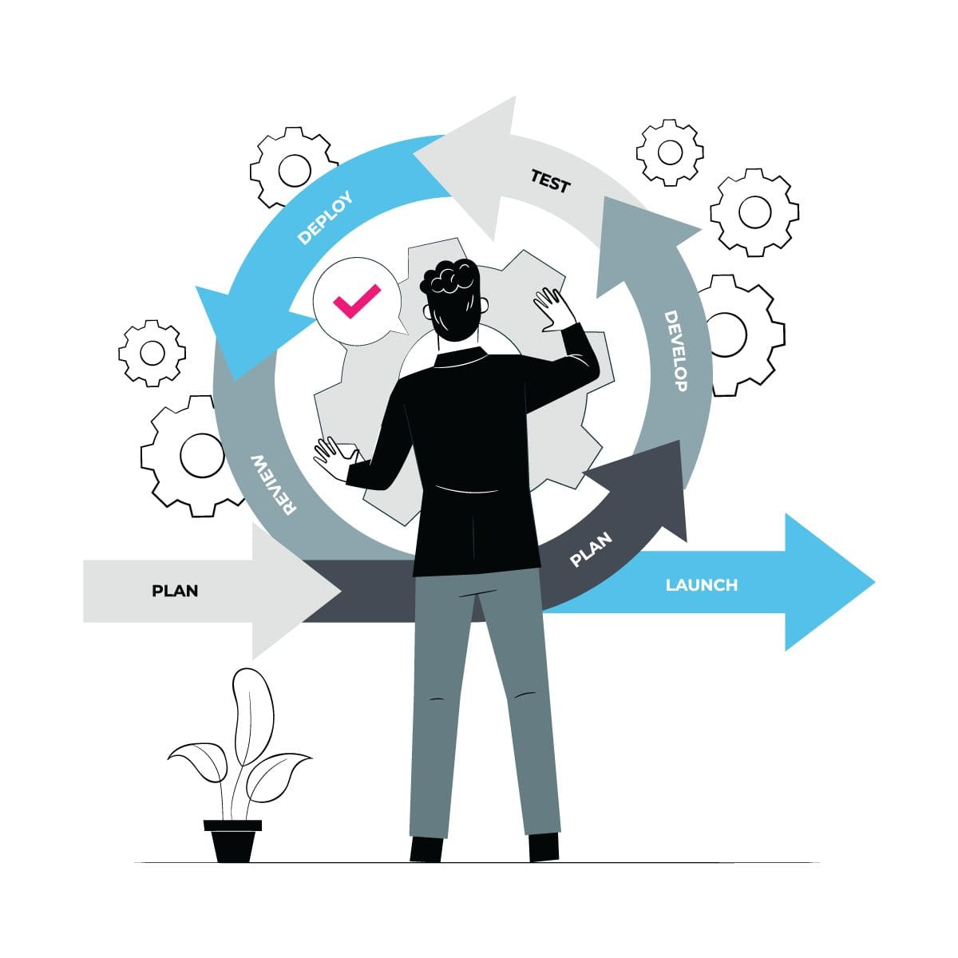
Lessons and Future Directions
Lessons for Stakeholders:
Users: Free VPNs cost data—prioritize privacy
Providers: Transparency, audits, and no-logs policies build trust
Educators: Address awareness gaps with VPN literacy programs
Future Research::
Develop educational campaigns for VPN data practices
Explore privacy-focused ad-supported VPN models
Evaluate mandatory third-party audits’ impact on trust
Assess older demographics’ VPN trust patterns
Notes:
"Key lessons emerge. For users, free VPNs aren’t free—your data is the price. Providers must prioritize transparency, audits, and no-logs policies to earn trust. Educators can close the awareness gap with VPN literacy programs. For future research, we propose developing educational campaigns, exploring privacy-respecting ad-supported VPNs, and evaluating mandatory audits’ impact on trust. Since our study skewed young, assessing older users’ trust patterns is another critical direction. These efforts can empower users and strengthen the VPN ecosystem."

Slide 14
Key Takeaways
🔐 Free ≠ Safe
Most users choose free VPNs for convenience, but at the cost of privacy and transparency.
🧠 Awareness Gap is Real
Nearly half of users don't understand how free VPNs handle data; most don't read T&Cs.
💡 Security-Savvy Users Avoid Free VPNs
Technical users overwhelmingly distrust and avoid free VPNs for sensitive tasks.
📊 Trust Must Be Earned
Transparency, clear privacy policies, and third-party audits are key to improving user trust.
📣 Education is the Way Forward
Empowering users through awareness can lead to safer digital behaviors.
Notes:
"Let’s leave with these takeaways: Free VPNs often sacrifice privacy for cost. Awareness gaps drive risky choices, but security-savvy users avoid free VPNs for sensitive tasks. Transparency and audits are essential for trust. Most importantly, education can empower users to make safer digital choices. Thank you!"

